Slide 1
How to preserve your sanity while writing a grant application
Efficiency is just intelligent laziness. – David Dunham (attrib)
Or, some tips for making your grant writing experience at least somewhat more pleasant than pulling teeth

Slide 2
Lots on the plate
Grant narrative
Lit review
Motivation
hypotheses
IRB
Grant budget
Personnel?
Equipment?
Timeline
And the worst part: it all has to be one coherent and consistent whole that is:
Easy to read
Easy to understand
Forceful and urgent

Slide 3
Some meta-goals
Ease of reading
Reduce the “cognitive load” on the reader
Define terms before you use them
Cut down on abbreviations
Avoid exquisitely grammatical sentences
“In addition, the paucity of practitioners fluent in other languages makes testing in the ethnic language even more difficult, and may delay services if assessment must wait until a qualified translator is available.”
“It is difficult to test in languages other than English because there are few speakers qualified to give the tests. This may lead to delays in the administration of services.”

Slide 4
Some meta-goals
Ease of reading
Reduce the “cognitive load” on the reader
Ease of understanding
Be consistent in the use of terminology
Use parallel constructions as much as possible
BAD:
In experiment 1,we will use a between-subjects design. A within-subjects design will be used for Experiment 2.
GOOD:
In experiment 1, we will use a between-subjects design. In experiment 2, we will use a within-subjects design.

Slide 5
Some meta-goals
Ease of reading
Reduce the “cognitive load” on the reader
Ease of understanding
Be consistent in the use of terminology
Use parallel constructions as much as possible
Forcefulness and urgency
Use active constructions (per your discipline)
Provide as much evidence as possible for any assertion of fact
BAD:
Multispeaker babble will be heard by participants, because it has been shown to be superior to other types of noise.
GOOD:
Participants will hear multispeaker babble because it is superior to other types of noise (Schnozz & Pumpernickel, 2010).

Slide 6
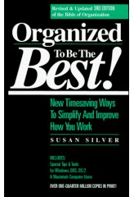
Organized to be the best!
Make appointments with yourself and keep them!
Commit to a designated time and place for writing for a period of time
“Writing your dissertation in 15 minutes a day”
“How to write a lot”
write short-term and long-term goals for the grant project
Feel good about yourself if you meet them, don’t beat yourself up if you don’t
Become one with your computer..

Slide 7
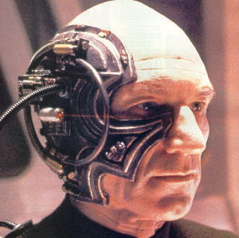
Resistance is futile
Your computer is not the receptacle of your brilliance
Consider it an active partner; a virtual extension of your brain (VEB)
To the extent possible: off-load information!
Your brain = storage of *ptr
The internet/ “Cloud”
With mobile computing, the VEB is with you wherever you go
Just a matter of interface. Should be:
Convenient, organized, easy-to-use
Doesn’t have to be expensive!
No iPhone necessary!
An ounce of computing trickery is worth a pound of time.

Slide 8
Starting simple..
Browser Extensions galore!
LeechBlock, Chrome Nanny
(you know you should!)
Adblock, DoNotTrack, Lastpass
Pure unadulterated awesomeness
Dropbox (duh!)/Box.com
Pocket (formerly ReadItLater)
App Launchers
Launchy (Windows)
Cmd-Space (Mac)

Slide 9
Buh-Bye Mouse!
OS keyboard shortcuts
Help->Keyboard shortcuts
Mac: System Prefs-Keyboard (“change to all controls”)
Alt-tab/Cmd-tab
Win: Ctrl-Tab/Ctrl-F6
Mac: Alt-~/Cmd-~
Good-bye, Mouse!
5 sec/fxn (conservative estimate)
100 fxns/day (consrv)
260 days/yr (consrv)
36.11 hrs/yr!!!

Slide 10
Gmail Tricks
Keyboard shortcuts (enable in settings)
j/k : move thru inbox
X : mark email
*-A : select all in inbox
Shift-I : mark as read
E : archive selected (btw: never delete!!)
# : delete
L : label
Canned Responses
Premade emails!
Multiple Inboxes
Sort based on next actions!
Quick Links
Easily access tags!

Slide 11
Keyboard shortcuts in MS Word
Windows shortcuts
X, C, P
A, S
Go to beginning or end of doc:
<home>,<end>
Move one page:
<pgup>, <pgdown>
Select one word/paragraph:
<shift + arrow>
Mac shortcuts
Same
Same
fn+Command+Left Arrow (or Right arrow)
Fn+down arrow (or Up)
Shift-Option-Arrow

Slide 12
Beyond Shortcuts: Making your word processor work for you
Search/replace (QL)
Also, Tools->Autocorrect (or 2008: word options --> proofing) (Mac: Preferences)
How to use Bookmarks effectively
Bookmarks Dialog → alt-n then k; Cmd-Shift-F5
Things to Bookmark:
Definitions
Figures/Tables
Overviews

Slide 13
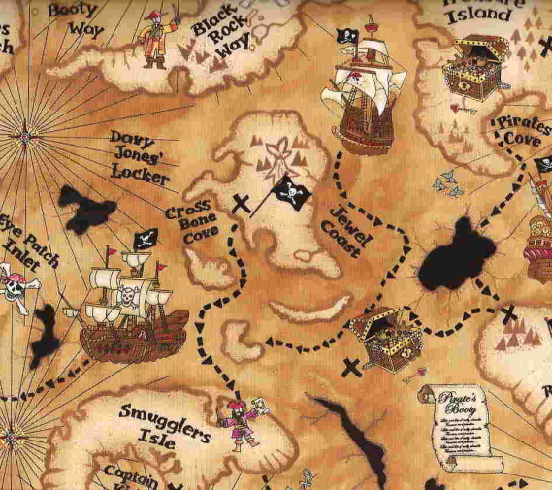
Love that Document Map!
Taking Bookmarks to the next level
Under View menu
Easiest if you outline before writing
Using the “Outlining” toolbar
Do-able if you write, then outline.
Use the “outline” toolbar to elevate text above “body text”
CAUTION: will use format and style rules from host document
However: the ‘continuation’ pages use the preferred format and style!

Slide 14
The Grand Triumvirate of Organization Apps
Todoist.com
Remember everything you need to do!
Evernote
Remember everything you need to know!
EndNote
Your lit at your fingertips!

Slide 15
TD
Tasks
Subtasks (and sub-subtasks)
Deadline to the minute
Priority
Recurrence
Unlimited reminders
Email or SMS
Unlimited Labels
Unlimited Notes
Each can be URLs, files, documents, or images
Evernote integration!
Can be associated with..
Projects
Subprojects (and sub-subprojects)
“Love” is not too strong of a word
Convenient, organized and simple
TD vs Zimbra task structure…
Zimbra
Task description
Location
Start date/end date
Priority
Progress
Notes
(tags)

Slide 16
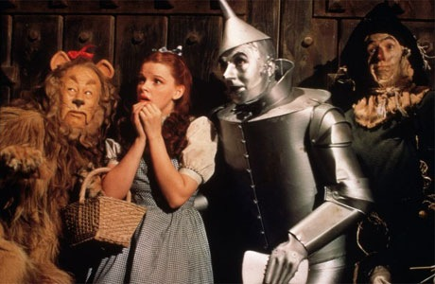
TD – Projects and labels (and notes, oh my!)
Lorin’s setup
Projects
General, Teaching, Research, Service, Personal
Subprojects
Teaching->Grad
Research->FIVEL, FLBL
Some suggested labels
grants, terms, timeline, budget, background, method
Labels vs Projects
Labels should crossref tasks across projects
Streamlined interface for tagging
Add while adding tasks by using “@”
Auto-completes with list of available labels
Searchable
By date, priority, label
Premium: text search on tasks and notes

Slide 17
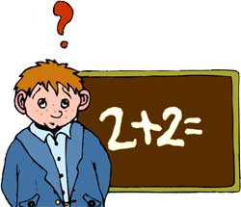
TD – advanced adding
Apps apps and more apps!
iOS, Android, web, desktop
Syncing across apps
Add tasks by email
Dedicated email address for inbox or for each project
Gmail integration!
SOOO useful

Slide 18
Notebooks and tags
Tag integration
(use the same tags in TD and Evernote for ease of cross-referencing)
Send notes to TD as reminders
Or use as notes within TD
Searches (text recog!)
“Students can demonstrate”
“Twedt”
“EricNet”
Saved searches
Google integration!
Sharing
But mods require pro acct
Clean it out! (set a TD reminder)
“One account. Many devices.”
Web client
Desktop client
Apps for smartphones, tablets
Unique email address
@foldername, #tag
Get in the habit of clipping stuff

Slide 19
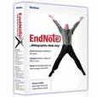
Singing the praises of Endnote
Let’s just say it’s awesome
Learning curve, but well worth the time investment
Return on investment is HUGE with time
Integration with library resources/Google Scholar

Slide 20
What does it do?
Automatic citation/reference list
Alt-1, Alt-2
Right-click for edits to citation style (date only, etc)
Formatted a la your favorite ref style
KEEPS TRACK FOR YOU
To et al, or not to et al; that is the question
Any remaining citations in document?
(don’t forget to hit “format bibliography” after changes)

Slide 21
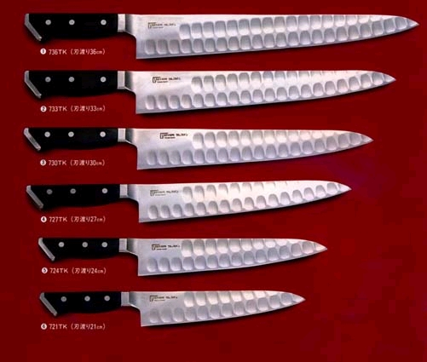
And that’s not all!
Manage figure/table captions
Enter your image files (jpg, bmp, gif, etc) in the reference library to insert in document
Keeps track of order of occurrence
Also helps with repeated references to the same figure/table

Slide 22
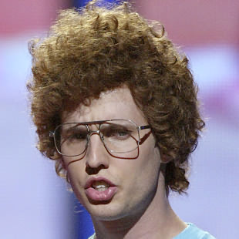
Head hurt yet?
Take these tips slowly
When in doubt, Consult the Geeks
Highly recommend TD first
The sooner you get started the sooner you can reap the benefits
P.S:
EyeDefender
Make a short-term goal each week to use one of these tips a lot
It counts as a ‘writing goal’!
By this time next year, you’ll be a power-user!

