Slide 1
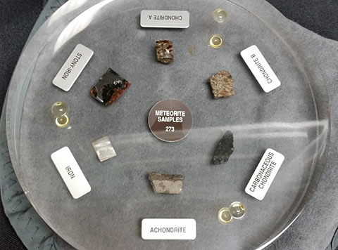
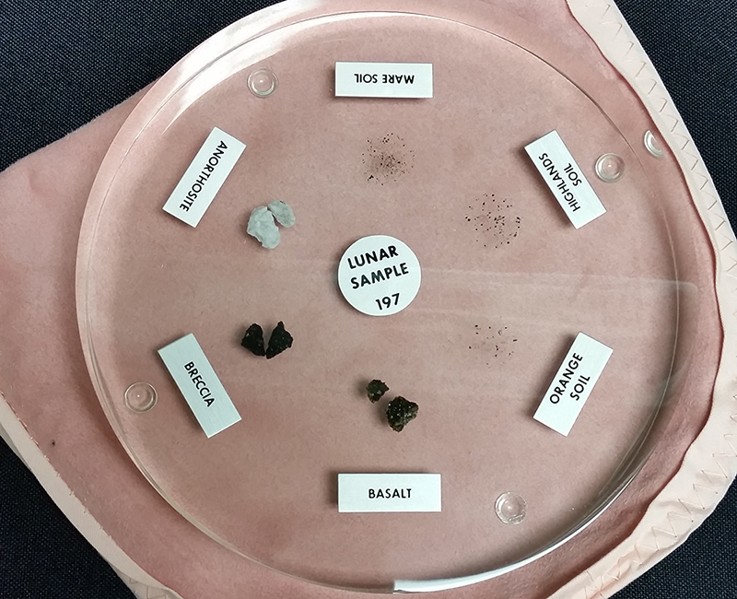
Physics Colloquium
Steve Harness, CSU Fresno
NASA Moon Rocks and Meteorite Samples
ABSTRACT
NASA is providing CSU Fresno with a sample of Lunar rocks and soils. For three years, between 1969 and 1972, NASA Apollo missions brought back 382 kilograms (842 pounds) of lunar material containing core samples, pebbles, sand, dust, and rocks. The study of these samples have contributed greatly to our knowledge of the Early history of the Moon, Earth, and solar system. Computer simulations demonstrate that the Moon may have been formed from material resulting from the Earth being struck by a glancing blow from a planetary body about the size of Mars. The chemical composition of the samples supports this theory on the origin of the Moon. From these studies we learned that the Moon’s crust formed around 4.4 billion years ago. There was an intense meteorite bombardment causing lava to flow on the surface. NASA is also providing samples of meteorites collected from Antarctica. As of 2016, different agencies have collected over 19,000 samples from the Antarctic region. The collection contains meteorite samples from Mars, Asteroids, and the Moon. The samples may include Chondrites, Achondrites, Brachinites, Carbonaceous, Iron, and Stony-Iron meteorites.
3:00-4:00 p.m., Friday, March 28th, 2025
In-person in McLane Hall 162

